Slide 1

6th Grade Accelerated Math
Unit 2, Lesson 3 Equivalent Conversions: Fractions ↔ Percentages – Part 2
Volume 1, pg. 51

Slide 2


Benchmark
MA.6.NSO.3.5
Rewrite positive rational numbers in different but equivalent forms including fractions, terminating decimals, and percentages.
volume 1, pg. 51

Slide 3
Integrated Mathematical Thinking and Reasoning Standards
MA.K12.MTR.3.1 Complete tasks with mathematical fluency.
MA.K12.MTR.4.1 Engage in discussions that reflect on the mathematical thinking of self and others.
volume 1, pg. 51

Slide 4

Learning Targets
I can convert between fractions and percentages.
I can rewrite positive rational numbers in different but equivalent forms.
volume 1, pg. 51

Slide 5

Warm-Up
volume 1, pg. 52

Slide 6
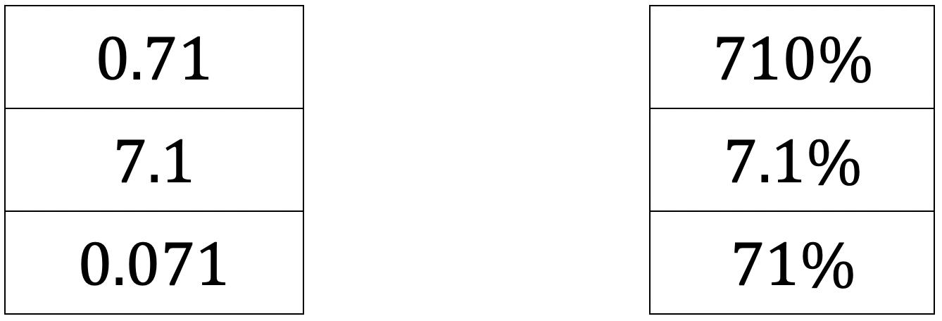
2.3.1 Warm-Up: Matching Puzzle
Several values, expressed as decimals and percentages, are given.
Match the values in the left column with their equivalent form in the right column by drawing lines to connect them.
2. Describe how you determined which values are equivalent.
volume 1, pg. 52

Slide 7

Guided Practice
volume 1, pg. 52

Slide 8

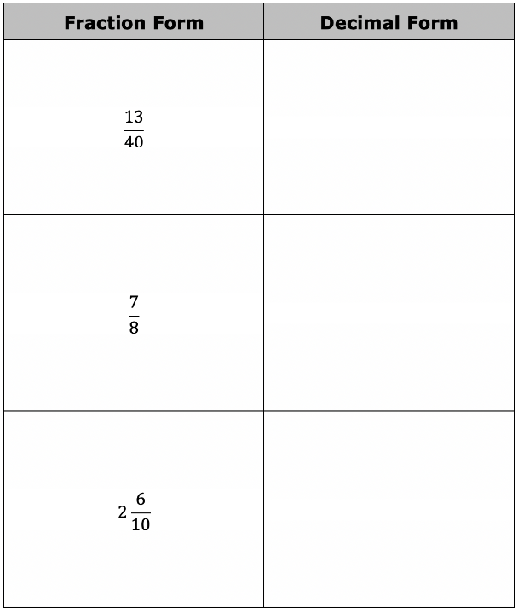
2.3.2 Guided Instruction: Rewriting Rational Numbers in Equivalent Forms
Recall from Lesson 1 that a fraction can be converted into its equivalent decimal form by dividing the numerator by the denominator.
Complete the table by rewriting the fraction
into an equivalent decimal form.
volume 1, pg. 52

Slide 9
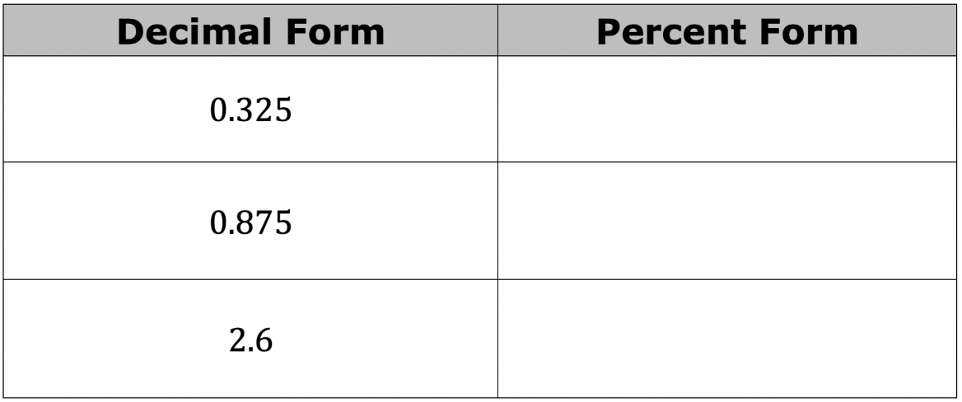

Complete the table by rewriting the decimal into an equivalent percentage.
3. What is the equivalent decimal form of ?
volume 1, pg. 53

Slide 10
4. What is 0.625 rewritten as a percentage?
5. What is rewritten as a percentage?
volume 1, pg. 53

Slide 11
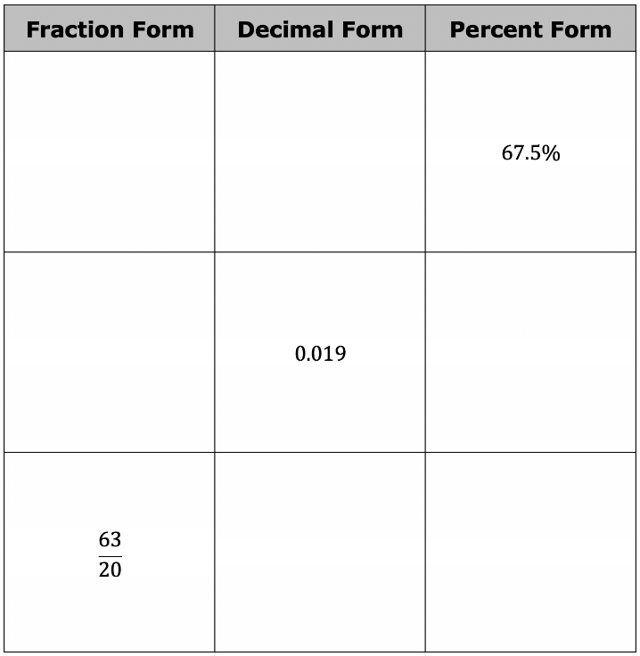
6. When rewriting a fraction as a percentage, why might it be helpful to first rewrite it in its equivalent decimal form?
7. Complete the table by rewriting each value in its equivalent forms.
volume 1, pg. 53

Slide 12

Collaboration
volume 1, pg. 54

Slide 13

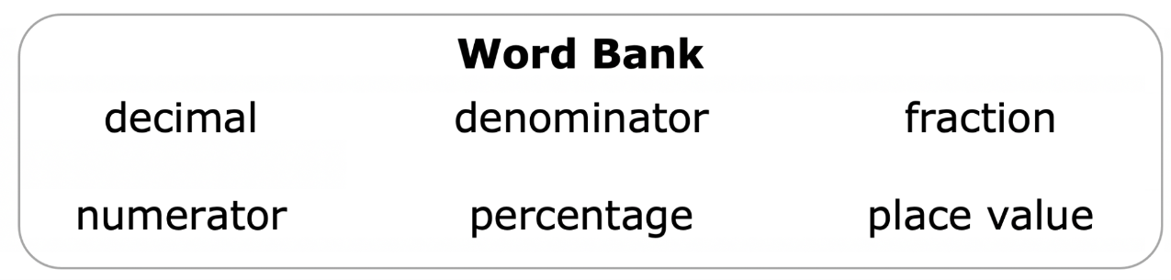
2.3.3 Collaboration: Strategies for Rewriting Rational Numbers
Working with your partner, use the words in the bank to complete each statement. Words can be used more than once.
To convert a ________________ to a decimal, divide the ______________ by the _______________.
2. Multiply the _______________ by to convert a ________________ to a ______________.
volume 1, pg. 54

Slide 14
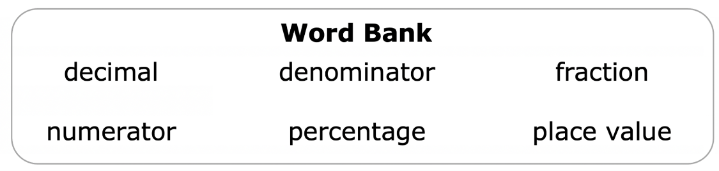
3. To rewrite a ________________ as a ________________, divide the ____________ by 100.
4. Use the _______________of the final digit to determine the denominator of the decimal when rewriting a ______________ as an equivalent ___________.
5. An equivalent fraction with a _____________ of 100 can be used to convert a _____________ to a percentage.
volume 1, pg. 54

Slide 15

Guided Instruction
volume 1, pg. 54

Slide 16
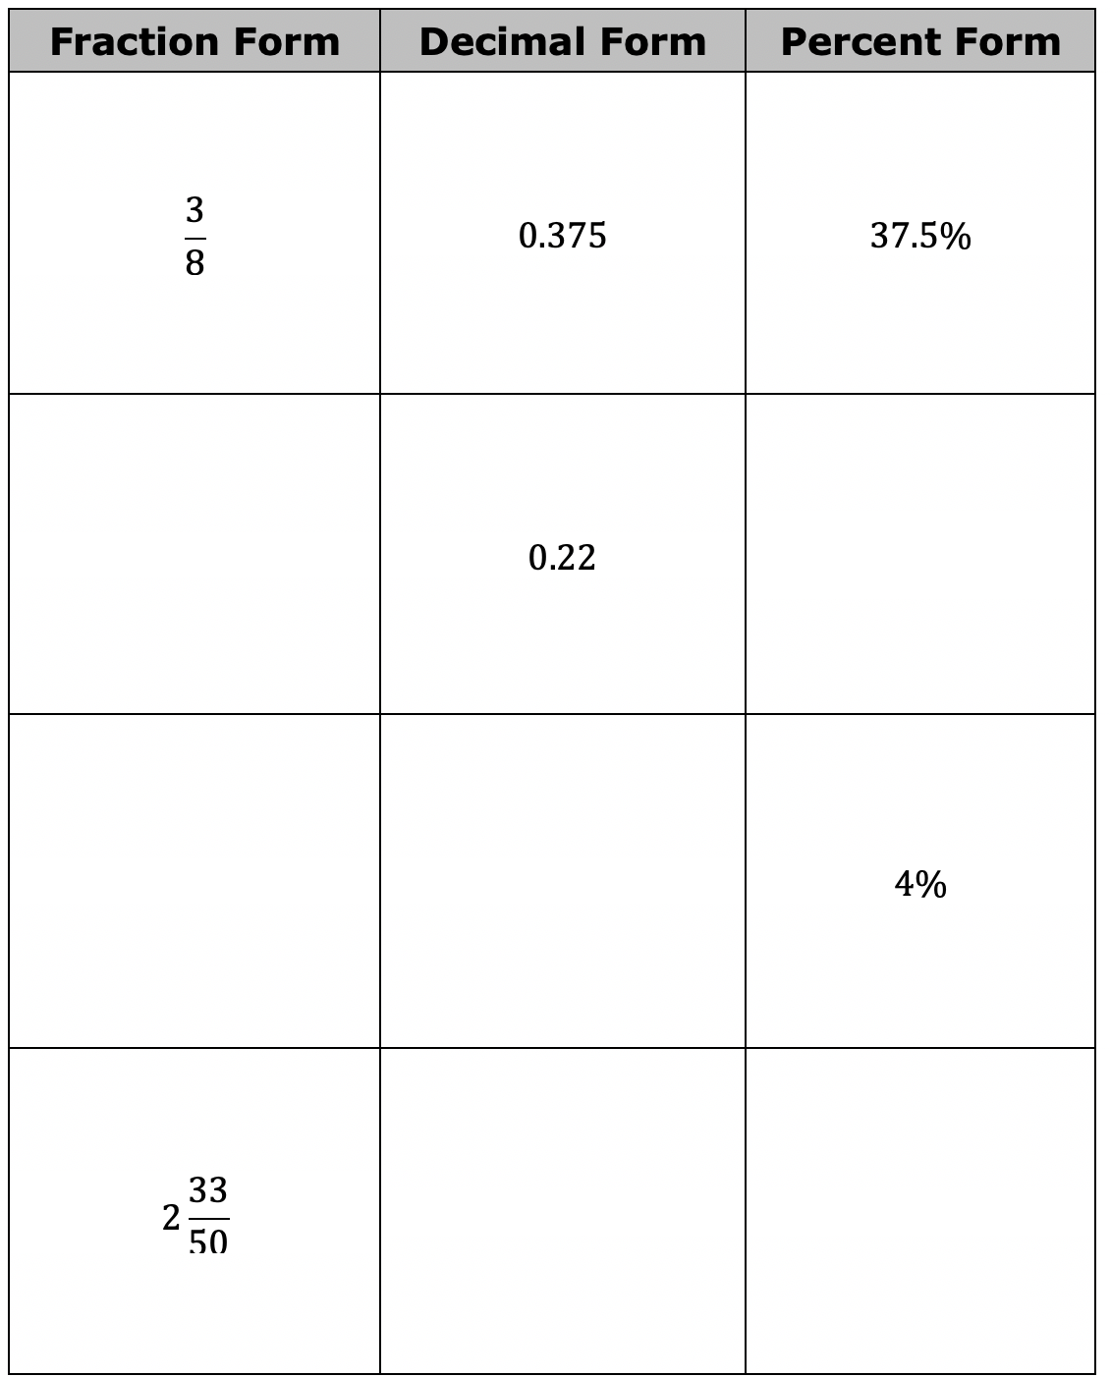
2.3.4 Guided Practice: Rewriting Rational Numbers in Equivalent Forms
Complete the table by rewriting each value in its equivalent forms.
volume 1, pg. 54

Slide 17

Wrap-Up
volume 1, pg. 55

Slide 18
2.3.5 Wrap-Up: Ticket Out the Door
Rewrite each value as an equivalent percentage.
2. Rewrite each value as an equivalent fraction.
volume 1, pg. 55

